Slide 1
TITLE SLIDE (final ppt)
PROJECT TITLE:
“AI-Powered Hunger Heat Map with Blockchain-Enabled Digital Food Token System for Equitable Food Access”.
TEAM MEMBERS:
S. J Monica
B. Monisha
DEPARTMENT: Computer Science and Engineering
GUIDE: Dr. Sangeetha K
PROJECT COORDINATOR:
Dr. Sangeetha K, Dr. Valarmathi K
BATCH: C13
SDG FOCUS:
Goal 2 – Zero Hunger
“End hunger, achieve food security, and improve nutrition.”

Slide 2
BASE PAPER DETAILS
PAPER TITLE:
"Digital Transformation of Food Supply Chain Management
Using Blockchain: A Systematic Literature Review Towards Food Safety and Traceability“
AUTHORS: K. Balachandra, N. Perera
JOURNAL/CONFERENCE: Springer, 2025
PUBLISHER: SpringerLink
OUR CONTRIBUTION:
We extend this research by implementing blockchain-backed
real-time hunger relief, enhancing food accessibility through
smart tokens.

Slide 3
ABSTRACT
THE CHALLENGE:
Widespread hunger continues to persist globally, driven by unequal food distribution, poor planning, and limited visibility.
PROJECT OBJECTIVE:
To design a technology-driven platform that utilizes AI to predict food-insecure regions and blockchain to ensure transparent food allocation using digital tokens.
WHY IT MATTERS:
Early prediction + blockchain transparency = faster and fairer hunger relief.

Slide 4
Social relevance
SOCIETAL BENEFIT:
This system bridges the gap between food wastage and food scarcity by redirecting surplus to those who need it most.
LINKED SDG:
Goal 2 – Zero Hunger.
Focuses on eradicating hunger and ensuring nutritious food availability.
REAL-WORLD RELEVANCE:
Helps relief organizations quickly locate and prioritize high-severity (red) hunger zones.
Strengthens disaster/crisis food response.
Promotes social equity through tech-driven aid.

Slide 5
introduction
CONTEXT:
Despite surplus food availability in many areas, logistical gaps and lack of intelligence lead to hunger remaining unsolved.
WHY THIS PROJECT?
We’re inspired by the need to bring innovation into hunger relief—using data to make smart, equitable food distribution decisions with complete traceability.
Combines GIS, QR codes, and data analytics for accurate decision-making.

Slide 6
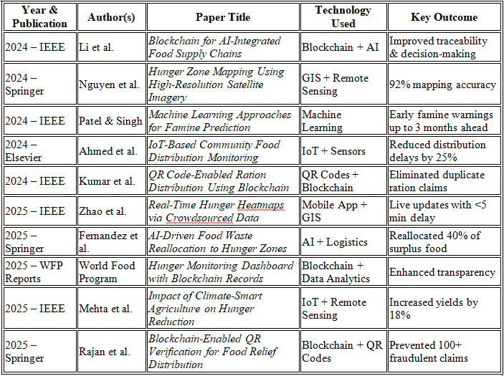
LITERATURE SURVEY

Slide 7
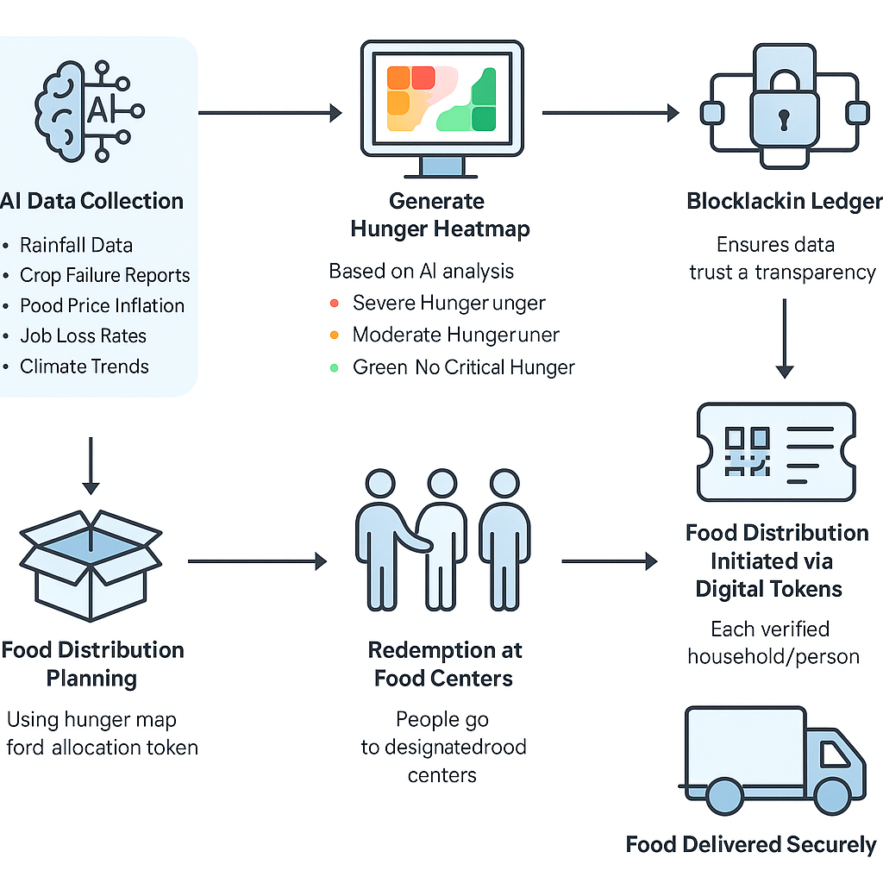
PROPOSED SYSTEM

Slide 8
Hardware/ software specification
HARDWARE:
Server/PC (8 GB RAM, i5+ CPU), mobile devices for token redemption.
SOFTWARE:
Python, Node.js, MongoDB, Blockchain framework (Hyperledger/Ethereum testnet).
APIs:
Weather data API, crop yield reports, price index APIs.

Slide 9
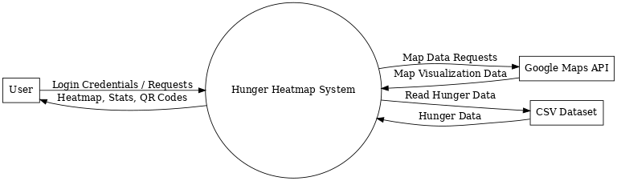
DATA FLOW DIAGRAM (dfd)
LEVEL 0:

Slide 10
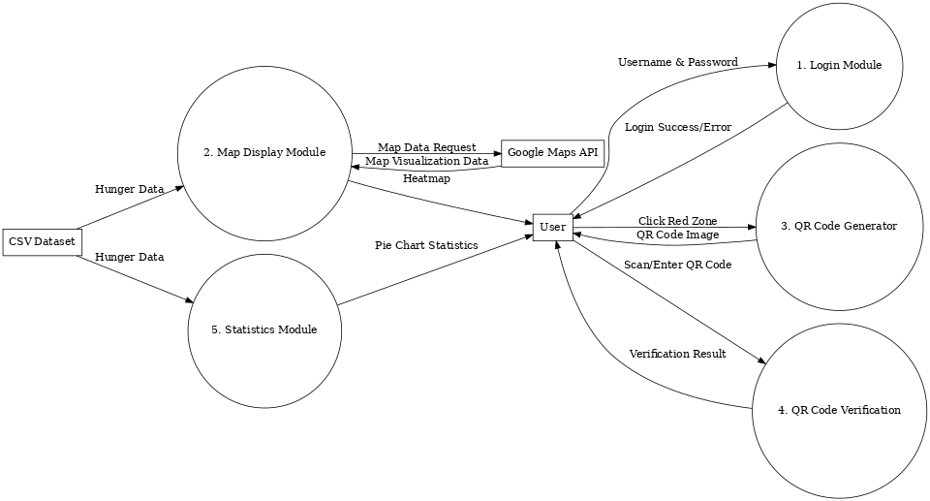
LEVEL 1:

Slide 11
MODULE EXPLANATION
Login Module :
Validates Admin/User credentials to grant secure access.
Map Display :
Shows Google Maps with hunger zones color-coded (Red, Orange, Green) based on Hunger Score.
QR Code Generator :
Creates unique QR codes for Red zones when clicked.
QR Verification :
Ensures QR codes are used only once; blocks repeated use.
Statistics Module :
Displays a pie chart showing percentage of Red, Orange, and Green regions.

Slide 12
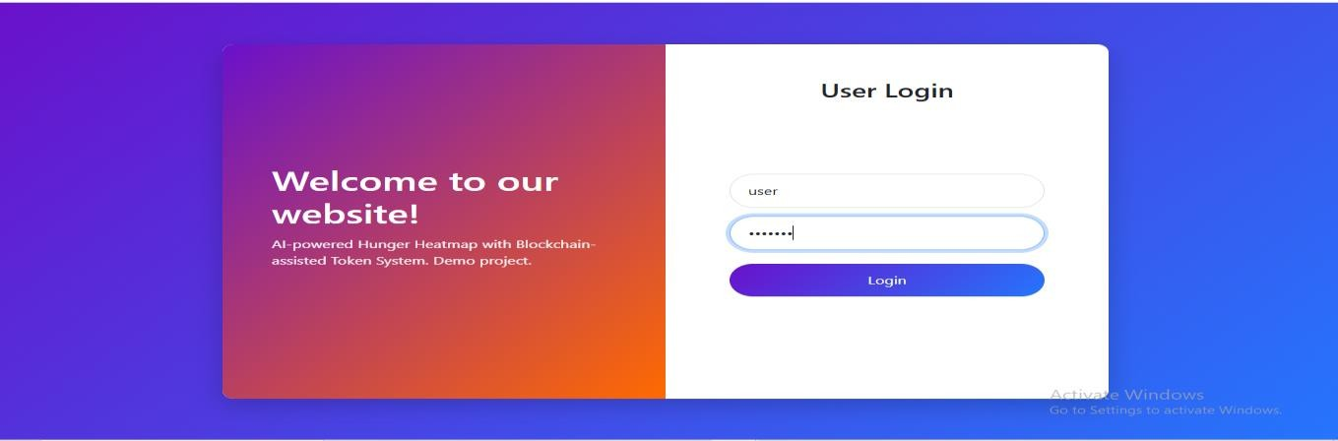
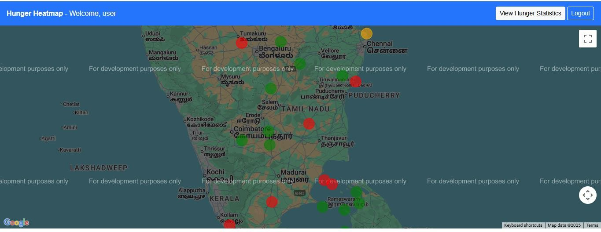
outcome

Slide 13
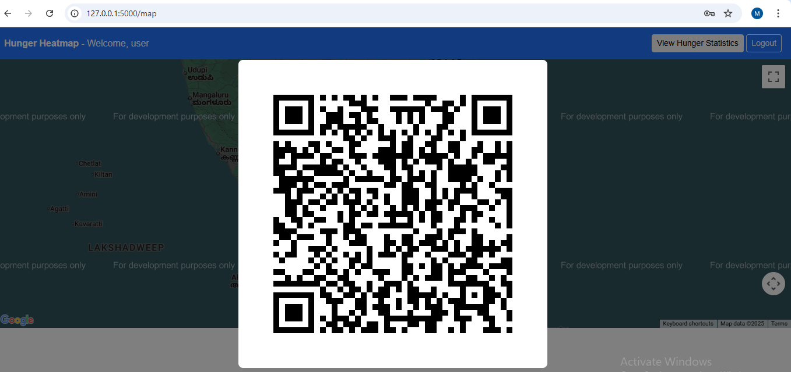
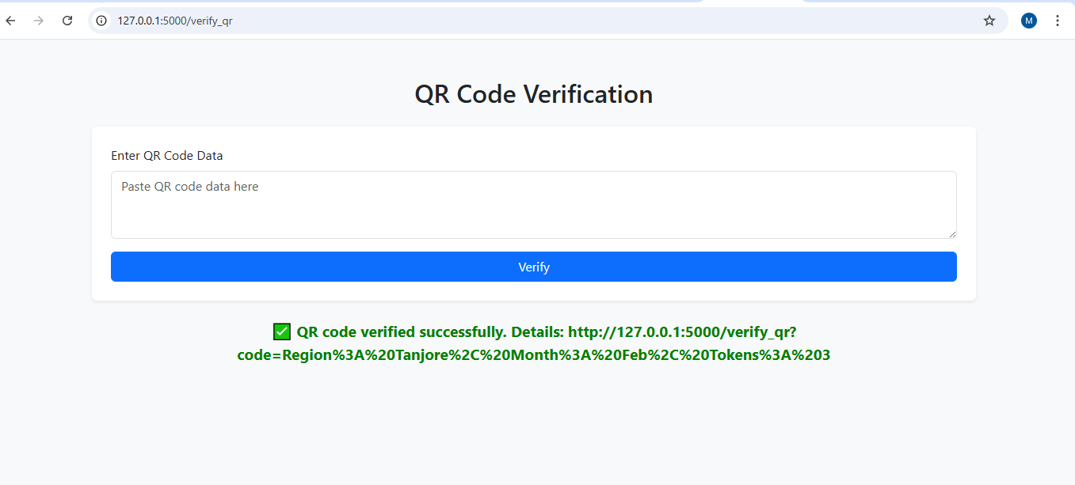

Slide 14
CONCLUSION & FUTURE SCOPE
CONCLUSION:
Our system shows how merging prediction algorithms with secure tech can transform hunger relief by making it faster, smarter, and fairer.
NEXT STEPS:
Add IoT for food condition monitoring.
Launch SMS mode for offline areas.
Collaborate with CSR / Govt food programs.
Integrate multi-language voice support.
File a patent and publish in Scopus/IEEE journals.

Slide 15
REFERENCES
M. Xie, Y. Li, H. Zhang, and F. Wang, “Digital Transformation of Food Supply Chain Management Using Blockchain: A Systematic Literature Review Towards Food Safety and Traceability,” Springer, 2025.
R. Sharma and K. Gupta, “Effective Food Waste Management Model for the Sustainable Agricultural Food Supply Chain,” Springer, 2024.
L. Thompson, A. Kumar, and M. Silva, “Food Loss and Waste Management in the Retail Food Supply Chain: Methods and Framework to Achieve Environmental Sustainability,” Journal of Cleaner Production, vol. 412, ScienceDirect, 2024.
P. Mehta and D. Raghavan, “Transitioning Towards Zero Waste in the Agri-Food Supply Chain: A Review of Sustainable Circular Agri-Food Supply Chains,” Sustainable Computing: Informatics and Systems, ScienceDirect, 2024.
J. Park, S. Chen, and K. Nguyen, “The Role of Industry 4.0 in Global Food Security: A Promising Pathway to Ending Hunger,” Trends in Food Science & Technology, ScienceDirect, 2024.

Slide 16
THANK YOU

